Slide 1
ENGINEERING FOUNDATIONS · MODULE 03
Conditions for Patent Protection
How to test whether an invention may qualify for a patent.
Notes:
Introduce the module as a practical overview. The focus is not on filing strategy for one country, but on the main questions engineers should ask before seeking protection.

Slide 2
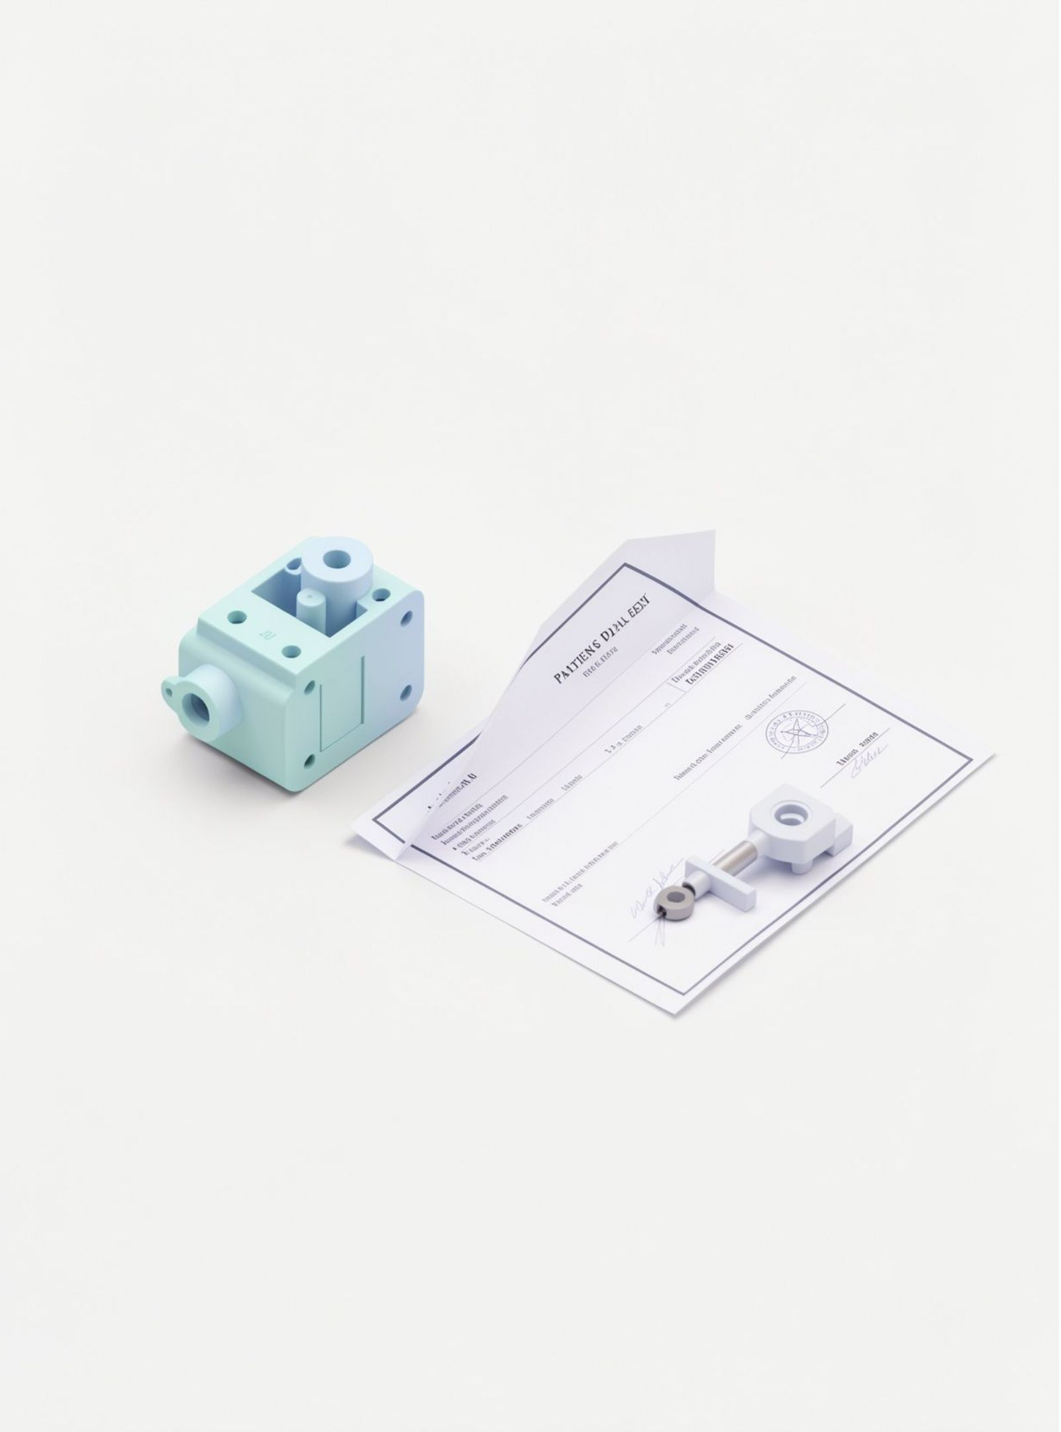



THE BASIC IDEA
What is a patent?
A legal right for an invention.
It can stop others from making, using, or selling the invention without permission.
In return, the inventor explains how it works.
Notes:
Explain the exchange at the heart of a patent. The inventor receives a legal right for a limited period under the relevant law, while the public receives a clear technical explanation.

Slide 3




CONDITION 01
First condition: the invention must be new
The same solution must not already be available to the public.
Search
Compare
Identify prior art
Test novelty
Patents, papers, products, and websites
Find what was already known or published
Earlier knowledge that can affect protection
Ask whether the claimed invention is genuinely new
Prior art means earlier knowledge made available before the relevant filing date.
Notes:
Define prior art in plain language: earlier knowledge that the public could access. A search does not guarantee protection, but it helps reveal whether the idea is already known.

Slide 4
CONDITION 02
Second condition: it must not be obvious
The invention must be a real step forward, not an easy next step.
The test
Obvious
Not obvious
Would a skilled engineer reach this solution easily, using common knowledge?
A fan with a motor is common. Adding a motor is an easy step.
A fan that cleans itself with a new mechanism is a bigger step, so it can be patented.
If the answer is yes, the idea is obvious and cannot be patented.
Notes:
Explain that a new idea can still fail this test. If a skilled engineer would easily get to the solution by combining known parts, the invention is obvious. Example: a fan with a motor is common; a fan that cleans itself with a new mechanism is a bigger step.

Slide 5



CONDITION 03
Third condition: it must be useful
The invention must work in practice, not only in theory.
Works
Has a use
More than theory
It performs the function it claims to perform.
It has an industrial or business application.
A purely theoretical idea is usually not enough.
Usefulness is often described as practical or industrial application. The exact legal test depends on the relevant law.
Notes:
Make the distinction between an interesting idea and a working invention. The invention should have a credible function and a real-world use.

Slide 6



BEFORE YOU SEEK PROTECTION
Other checks before protection
Allowed subject
Clear disclosure
Correct office
The subject must be allowed by the law.
The application must explain the invention clearly enough to reproduce it.
File with the correct national or regional patent office.
Notes:
Patentability is only one part of the process. Subject-matter rules, disclosure quality, and filing jurisdiction can all affect the result.

Slide 7




A STRATEGIC CHOICE
Why choose a patent?
Protects a valuable technical solution.
Can support licensing, investment, and business advantage.
Useful when competitors could copy the product easily.
Notes:
Frame a patent as a business and engineering choice, not an automatic step. It can be valuable when the technical solution matters commercially and copying would be easy.

Slide 8
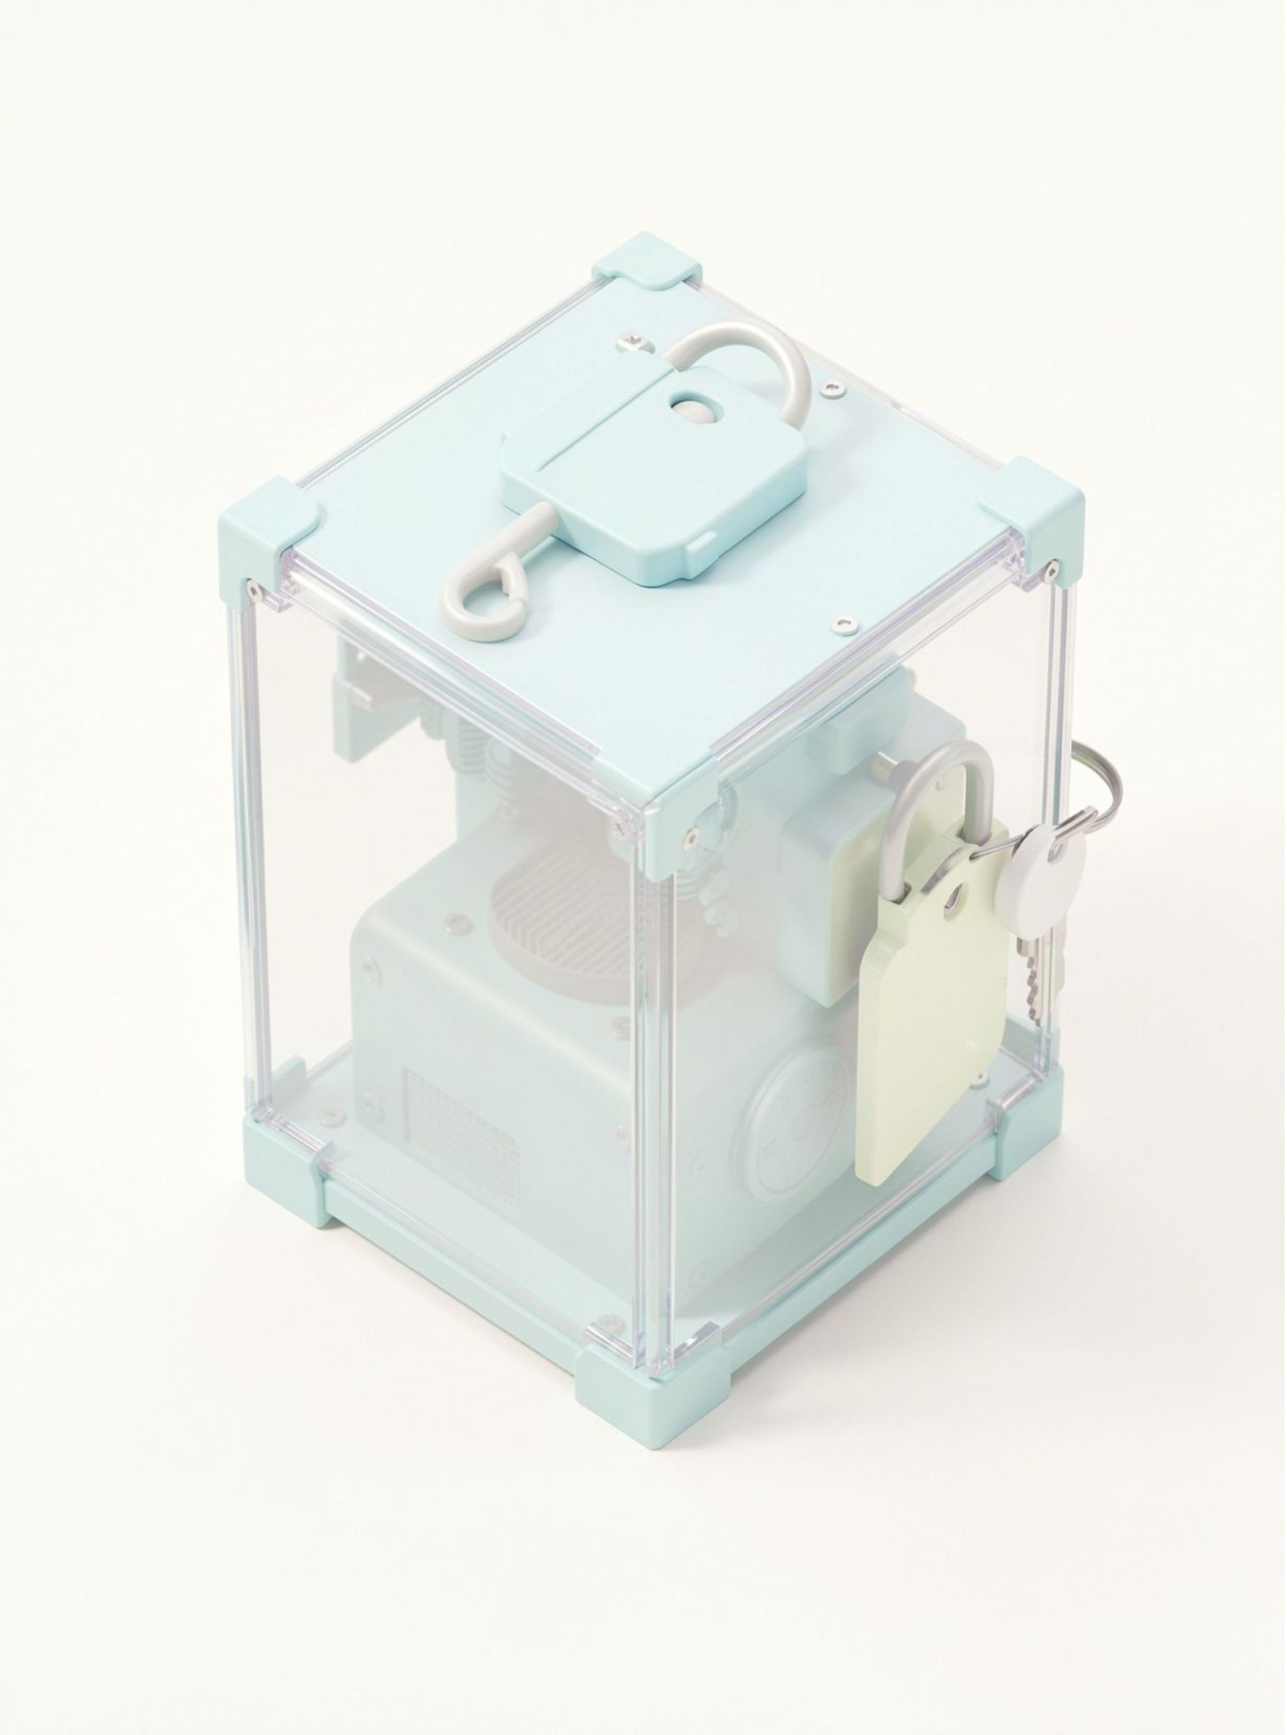
ANOTHER PATH
Why choose not to patent?
Cost and time
Public disclosure
Trade secret
A confidential process may fit better when it is hard to discover.
Patent applications take time and money.
The invention becomes public through the application.
Notes:
Explain the trade-off. A patent gives public disclosure in exchange for protection. A trade secret may suit information that can remain confidential and is difficult for others to discover independently.

Slide 9
A PRACTICAL FIRST PASS
Is it new? Search for prior art.
Is it a real technical improvement? Test the inventive step.
Can it be used in industry? Show a practical use.
Would public disclosure help more than secrecy? Compare disclosure and protection.
Ask a patent professional before filing.
A simple decision guide
Use these questions to decide what to investigate next.
This is a general overview. National laws differ, so check with the relevant patent office or a qualified patent professional.
Notes:
Use the guide as a conversation starter, not a legal conclusion. The final decision should be checked against the relevant national or regional rules and, where appropriate, with a qualified patent professional.

